Slide 1
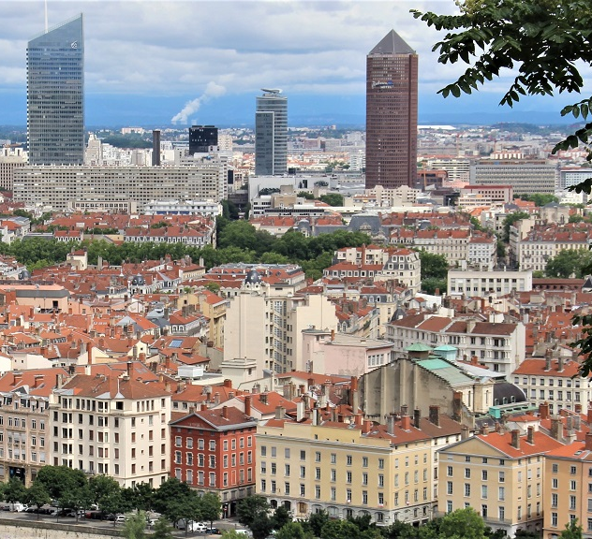

Welcome to Lyon & the SEPR Centre!

Slide 2
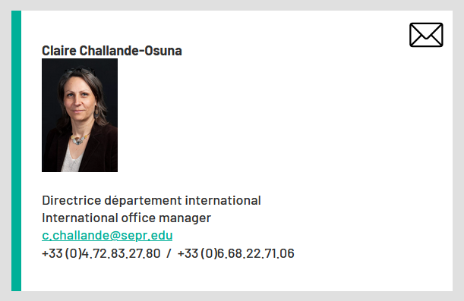
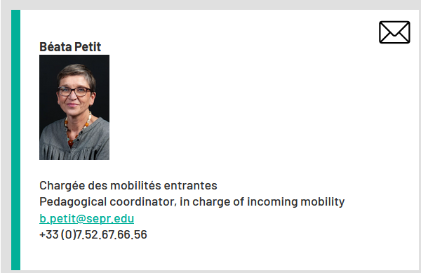
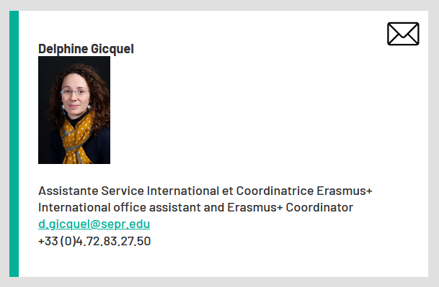
Your SEPR contacts
Volunteers (Academic year 21/22) :
Coraline CAVAGNA
Canan-Julide TURKKAN

Slide 3
SEPR Lyon France

Slide 4
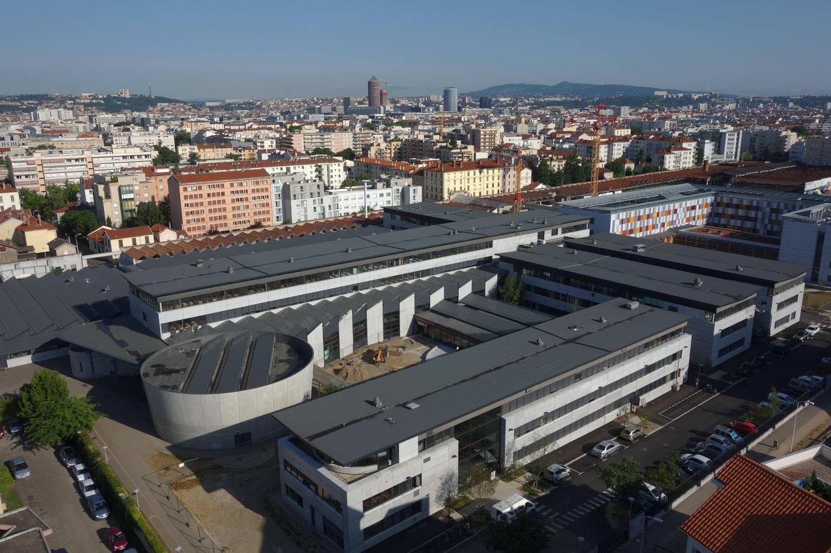
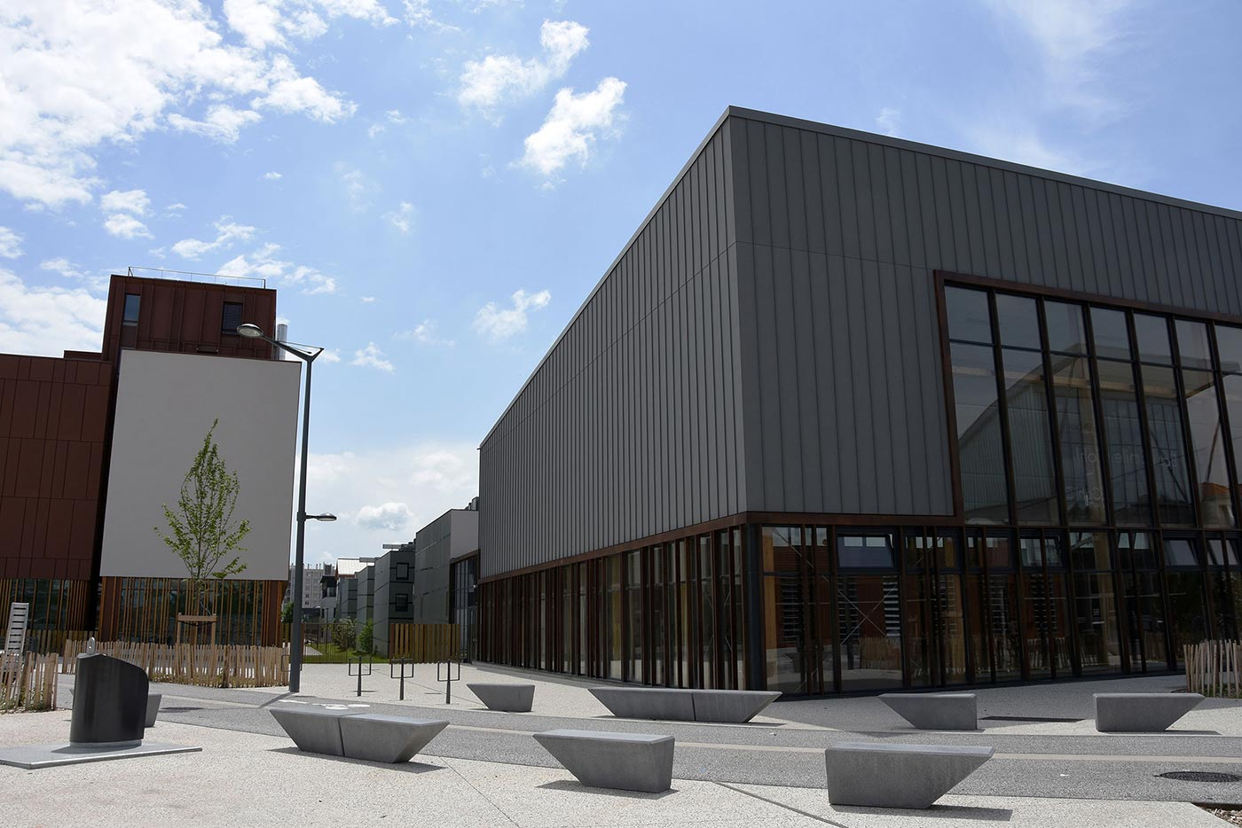
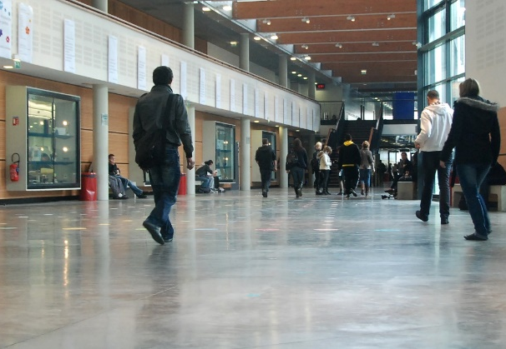
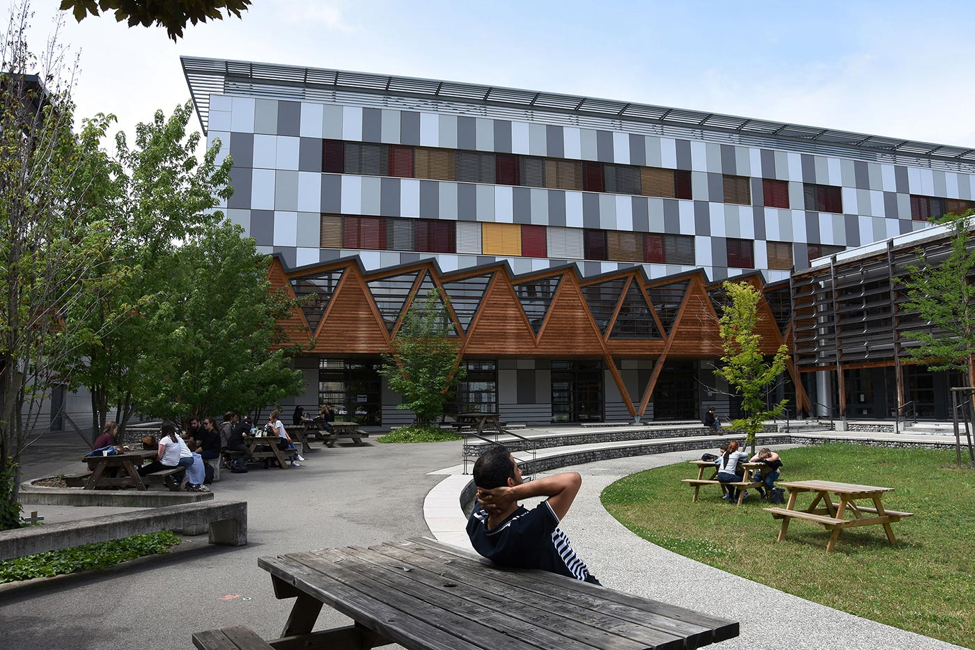
SEPR overview

Slide 5
SEPR : a long tradition of VET…

Slide 6
SEPR training paths
EQF level 3 to EQL level 6
Training path | Number of learners
Apprenticeship Dual system | 3 000
Full-time training | 800
Continuous training | 400
Total | 4 200 learners

Slide 7
6 fields of excellence

Slide 9
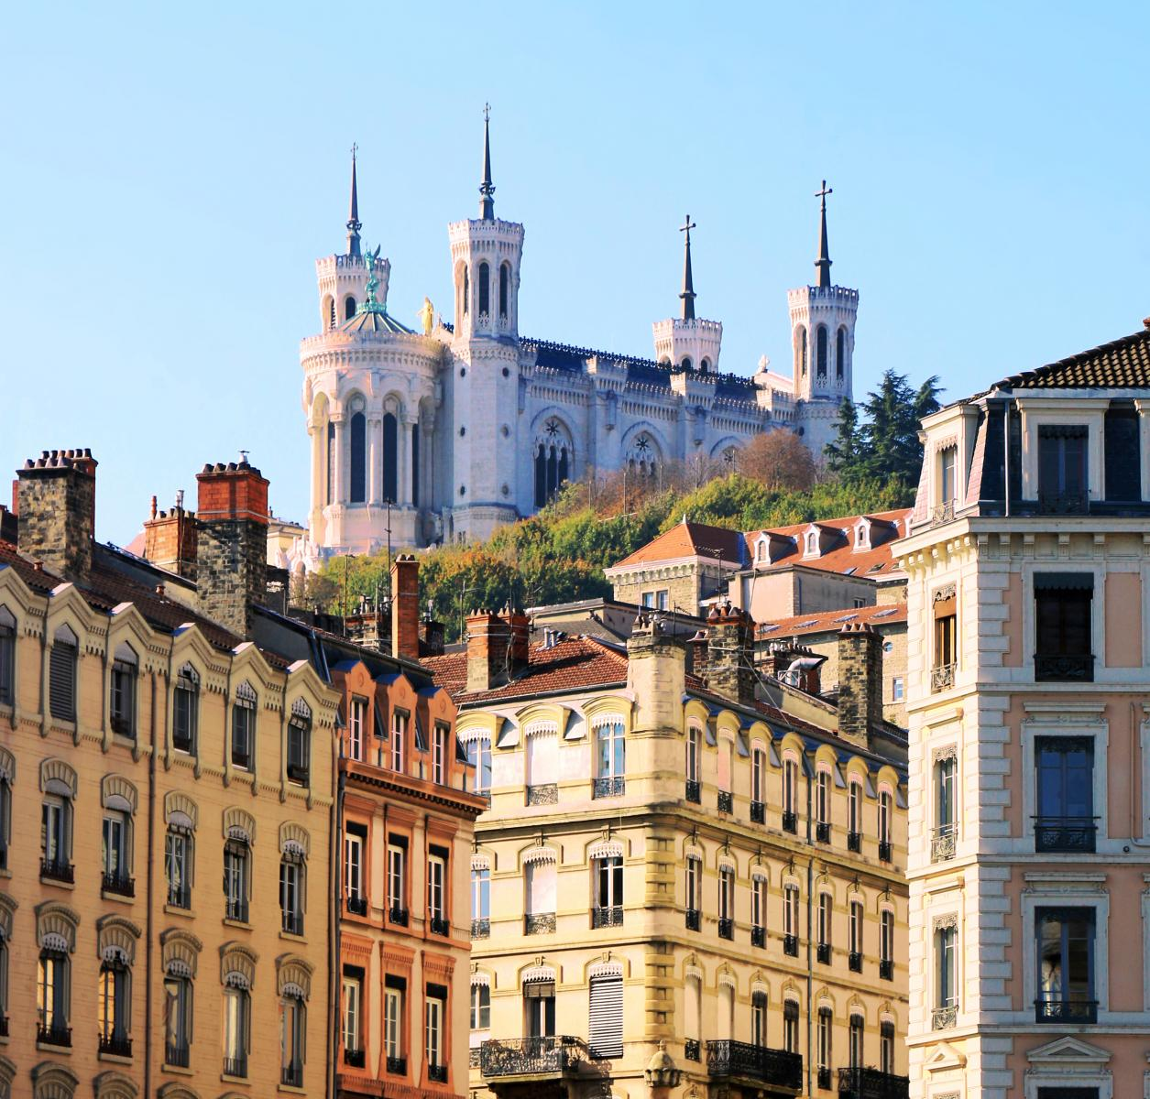
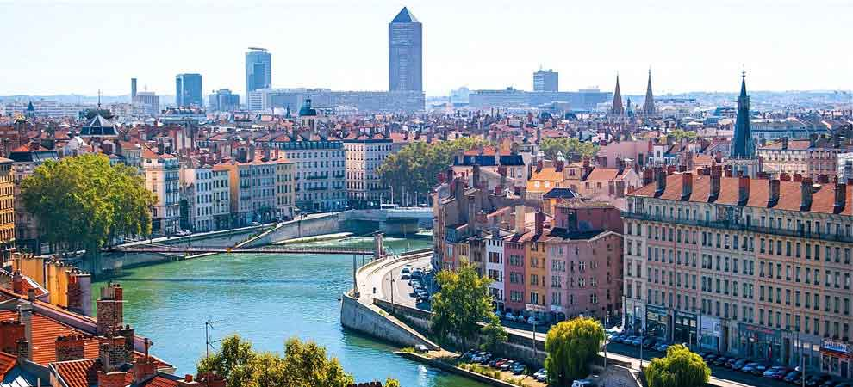
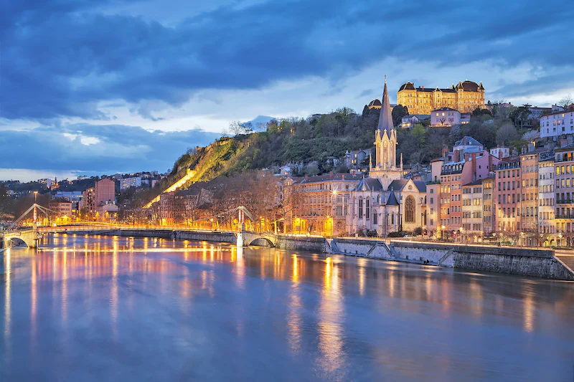
Lyon description
518 635 inhabitants
3rd most populated city in France
47.87 km² surface area

Slide 10
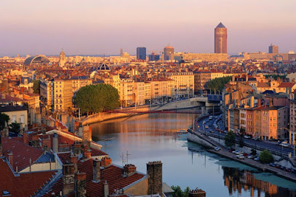
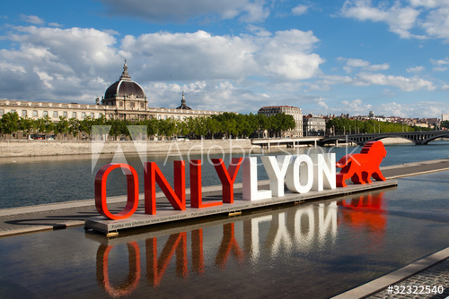
The city of Lyon
Lyon, a UNESCO World Heritage site since 1998
With a rich history spanning 2,000 years, the city of Lyon has a remarkable architectural heritage. The city has 500 hectares in the heart of town listed as a UNESCO World Heritage Site.
Lyon, City of Gastronomy
Lyon is famous all over the world for the art of fine living, with many Michelin-star restaurants, famous chefs, typical "bouchon" restaurants, café bistros and avant-gardist dining experiences.
Lyon, city of events
Throughout the year, Lyon is alive with many events (Festival of Lights, the Contemporary Art Biennale, the Dance Biennale, the Nuits Sonores all of which attract millions of visitors each year.

Slide 11
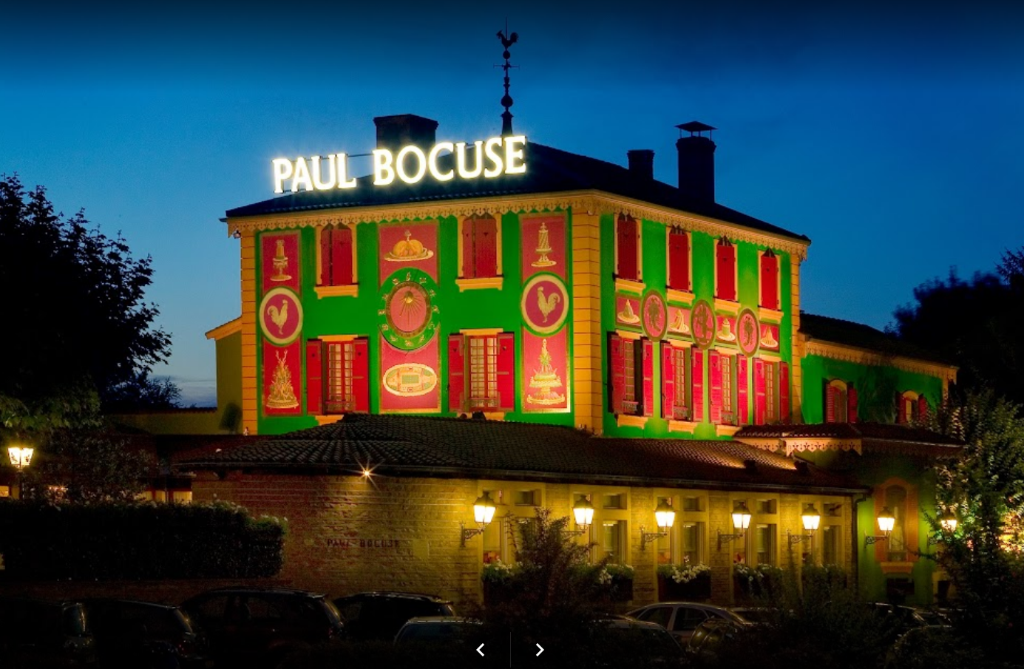
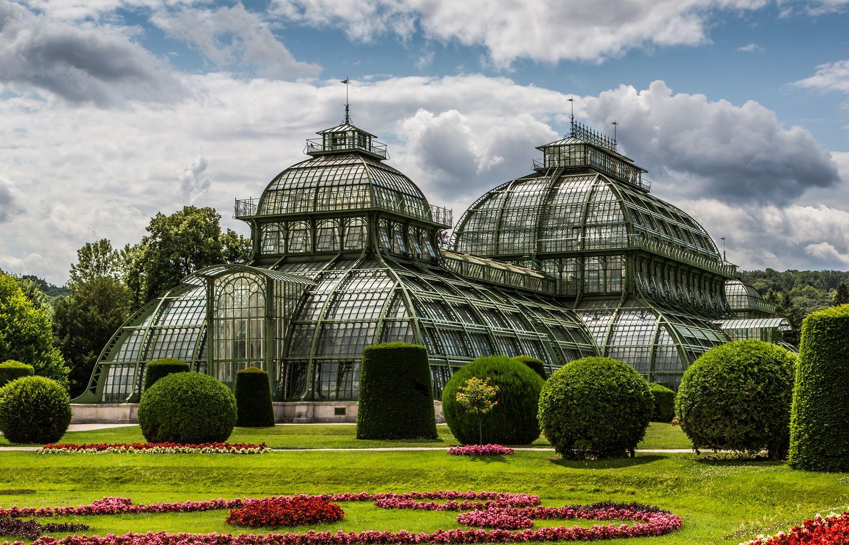
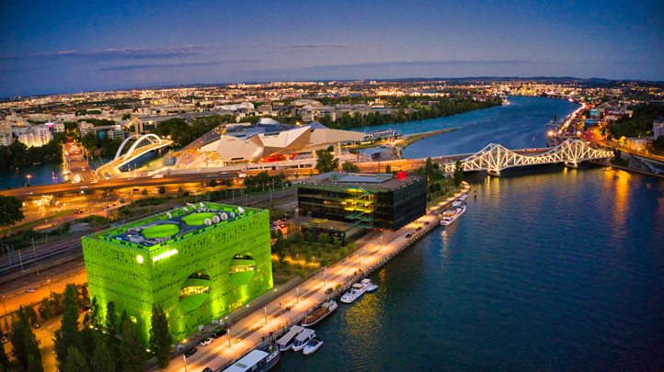
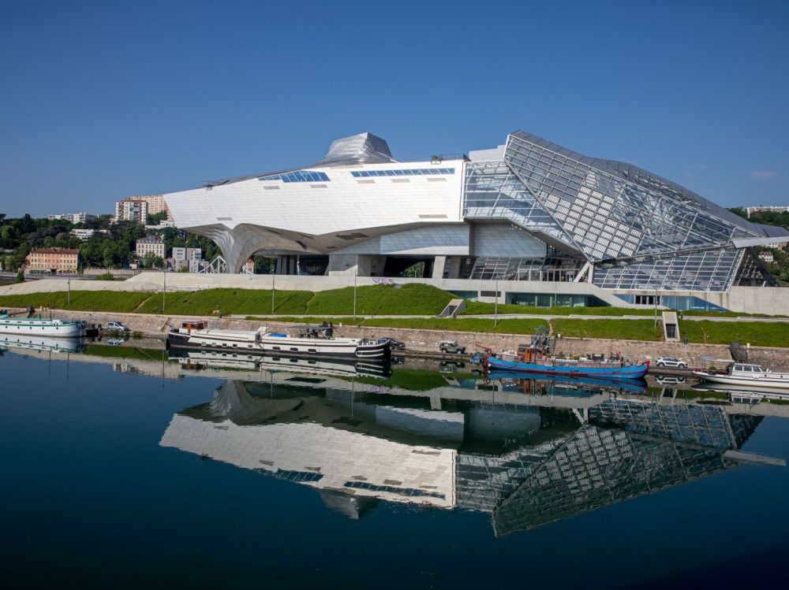
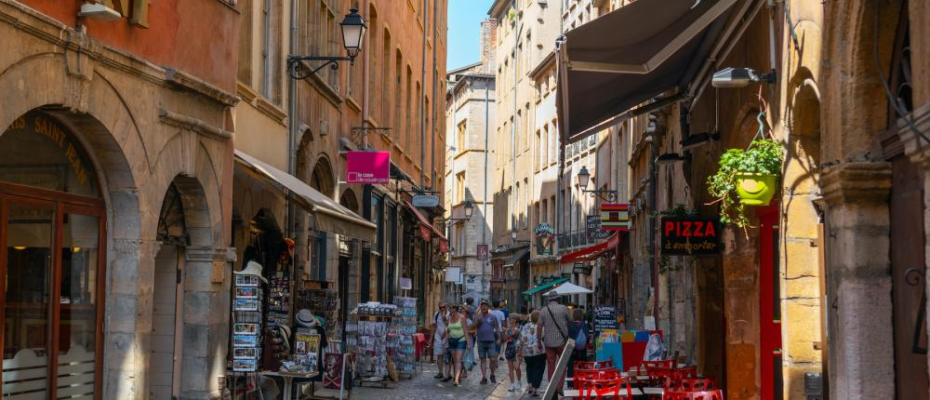
Cultural visits

Slide 12
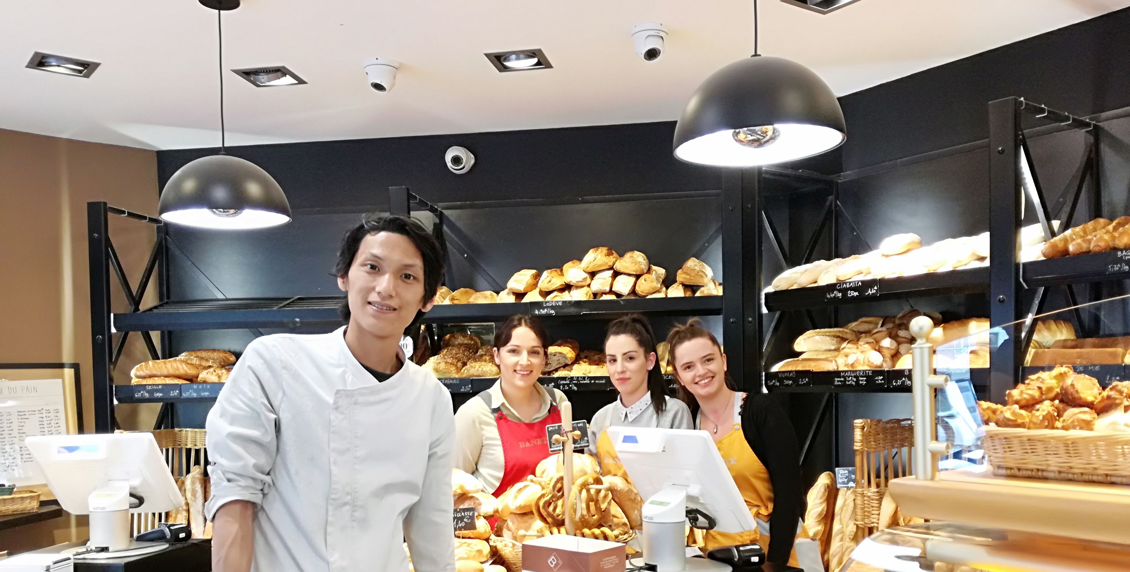
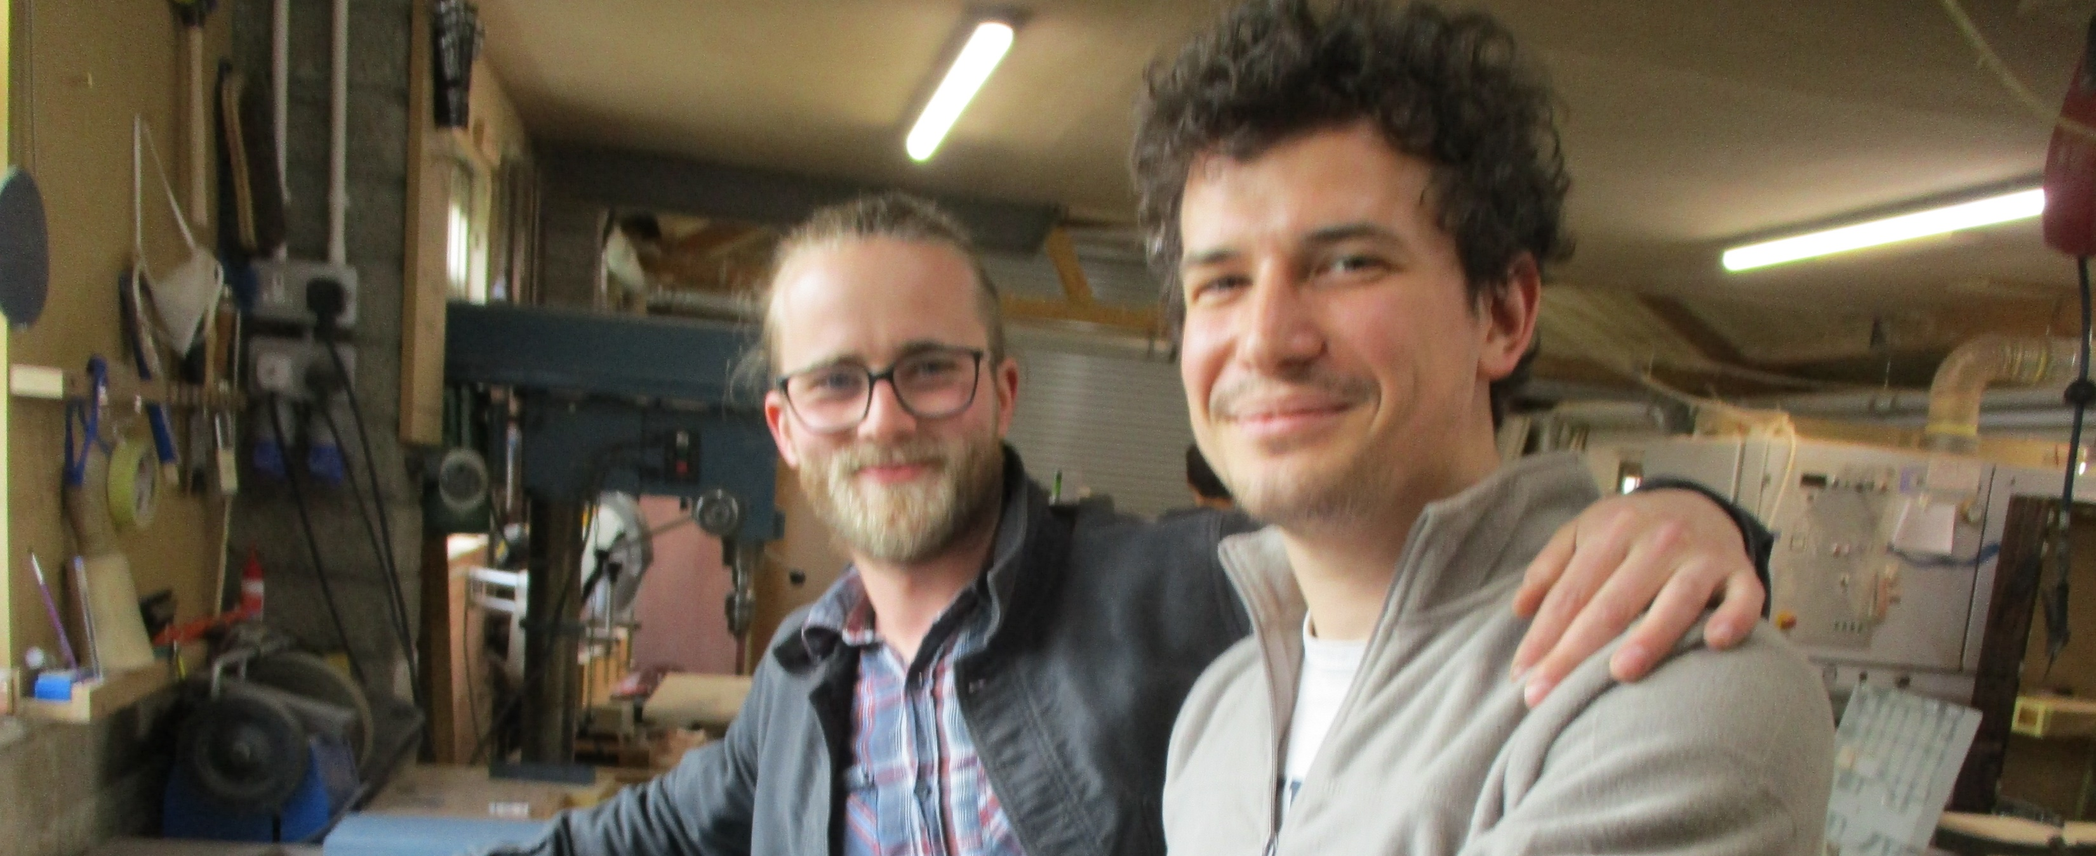
SERVICES PROPOSED
WORK PLACEMENT
company research and placement,
welcome and transfer from/to airport/bus/train station
introduction to the company on the first day
personalized follow-up and assistance throughout the training period
assessment and completion of administrative issues ((internship agreement, Erasmus annexes, Europass...)
accommodation booking
Certificate of Training delivered by the SEPR

Slide 13

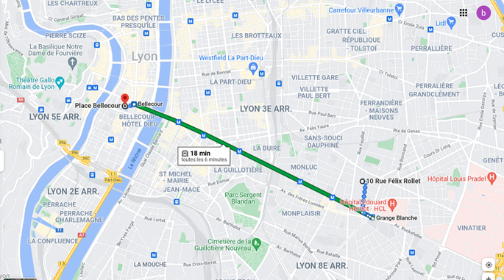
Residence Rochaix Aralis
Address:
10 rue Félix Rollet
69003 LYON
Walking distance to the city center Place Bellecour is around 50 minutes
Time by Metro line D (Lyon underground) to the Place Bellecour is 20 minutes, every 5 minutes
Walking distance from the residence to the Metro is 5 minutes
You can use Google Maps or Citymapper on your Smartphone

Slide 14
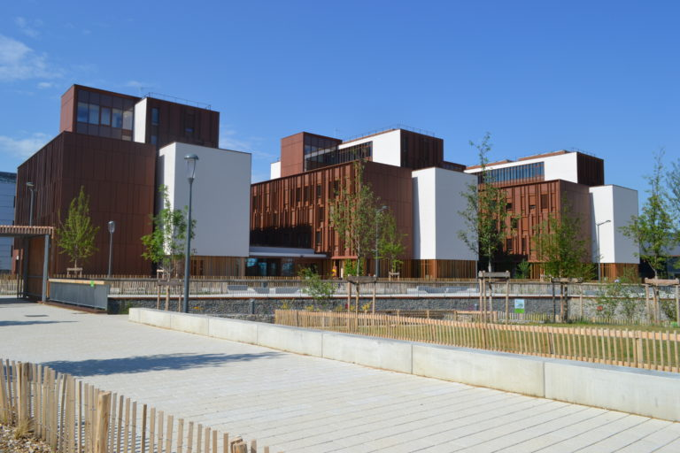
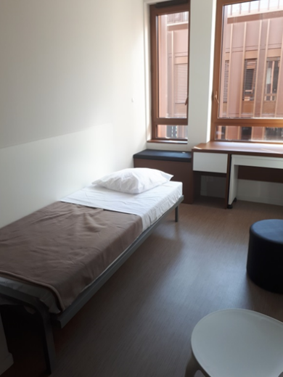
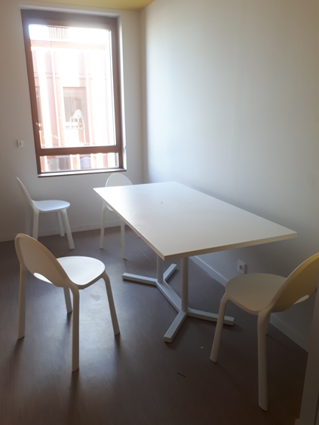
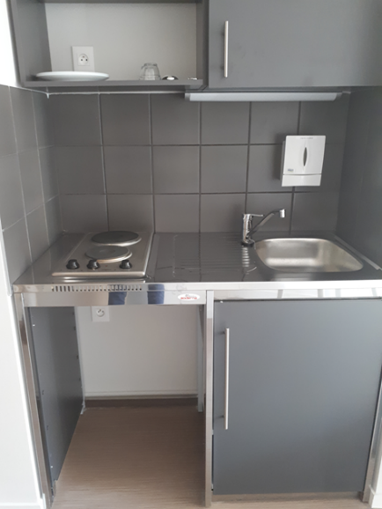
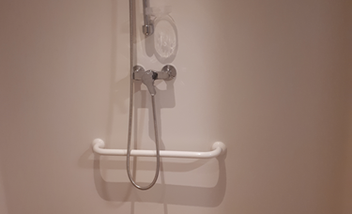
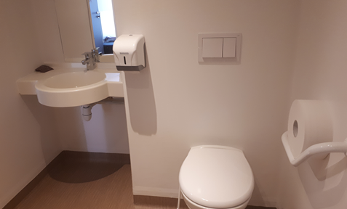
Residence Rochaix Aralis
GENERAL DESCRIPTION & EQUIPMENTS
The residence is made up of three buildings , two of them are accommodations for students.

Slide 15
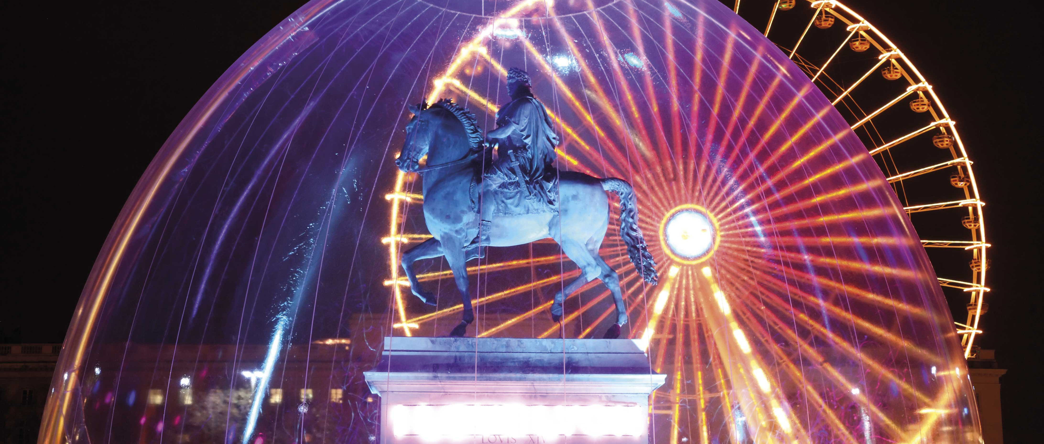
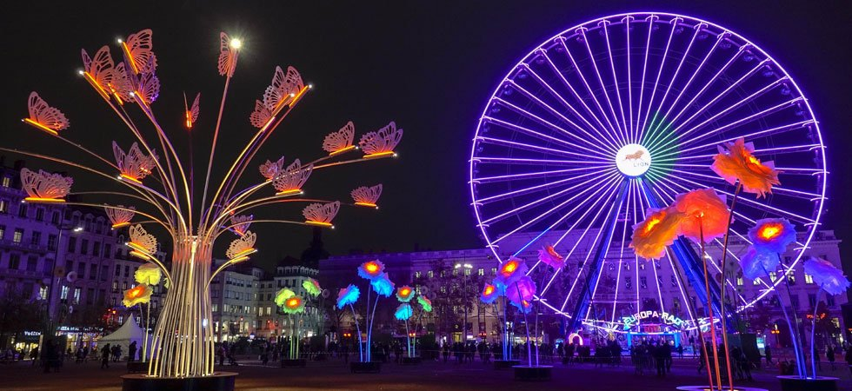
Enjoy your work placements, enjoy Lyon !

